Slide 1

Testing and Verification (CSC7056/CSC3056)
Aidan McGowan
Experienced based techniques

Slide 2

Experienced based testing
In experience-based testing, people’s knowledge, skills and background are of prime importance to the test conditions and test cases.

Slide 3

Experienced based testing
The experience of both technical and business people is required, as they bring different perspectives to the test analysis and design process.
Because of the previous experience with similar systems, they may have an idea as what could go wrong, which is very useful for testing.

Slide 4
Experienced based techniques
Experience-based techniques go together with specification-based and structure-based techniques, and are also used when there is no specification, or if the specification is inadequate or out of date.
This may be the only type of technique used for low-risk systems, but this approach may be particularly useful under extreme time pressure – in fact this is one of the factors leading to exploratory testing.

Slide 5
Experienced based techniques
Two main types
  Error Guessing
  Exploratory testing

Slide 6

Error Guessing
Error Guessing
The Error guessing technique is where experienced testers are encouraged to think of situations in which the software may not be able to cope.
A structured approach to error guessing is to enumerate a list possible defects and to design tests that attack these defects. This approach is known as a fault attack.

Slide 7
Error Guessing
Success of error guessing is very much dependent on the skill of the tester.
Used after more formal techniques have been applied to some extent, Error Guessing can be very effective.
In using more formal techniques, the tester is likely to gain a better understanding of the system, what it does and how it works. With this better understanding, he or she is likely to be better at guessing ways in which the system may not work properly.

Slide 8
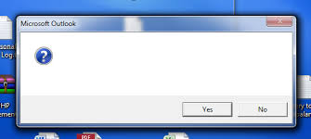
Error Guessing – examples
Division by zero
Blank (or no) input
Empty files
Wrong kind of data entered (e.g. alphabetic characters where numeric are required)

Slide 9

Exploratory testing
About exploring, finding out about the software, what it does, what it doesn’t do, what works and what doesn’t work.
The tester is constantly making decisions about what to test next and where to spend the (limited) time.
Useful when there are no or poor specifications and when time is severely limited.

Slide 10
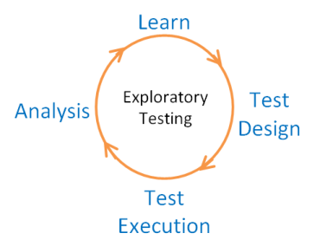
Exploratory testing
Exploratory testing is a hands-on approach in which testers are involved in minimum planning and maximum test execution.

Slide 11

Exploratory testing
The planning involves the creation of a test charter, a short declaration of the scope of a short (1 to 2 hour) time-boxed test effort, the objectives and possible approaches to be used.
The test design and test execution activities are performed in parallel typically without formally documenting the test conditions, test cases or test scripts.
This does not mean that other, more formal testing techniques will not be used.

Slide 12

Exploratory testing
For example, the tester may decide to use boundary value analysis but will think through and test the most important boundary values without necessarily writing them down. Some notes will be written during the exploratory-testing session, so that a report can be produced afterwards.

Slide 13
Exploratory testing
Test logging is undertaken as test execution is performed, documenting the key aspects of what is tested, any defects found and any thoughts about possible further testing. It can also serve to complement other, more formal testing, helping to establish greater confidence in the software.
In this way, exploratory testing can be used as a check on the formal test process by helping to ensure that the most serious defects have been found.

Slide 14
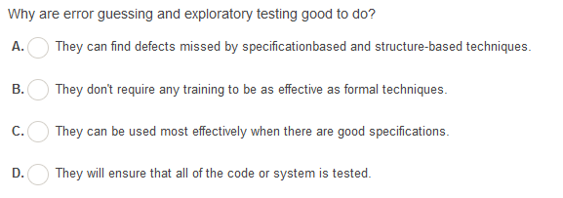
Notes:
A

Slide 15
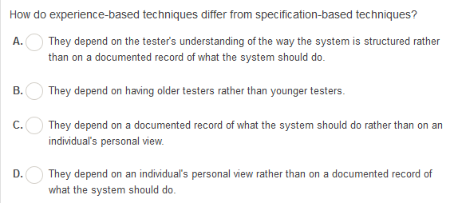
Notes:
D

